Slide 1
Chapter 9
Going from Data to UI in React

Slide 2
Objectives
The Example
Dealing with Arrays

Slide 3
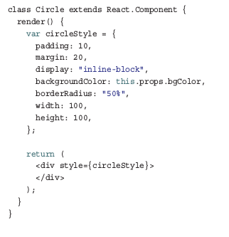
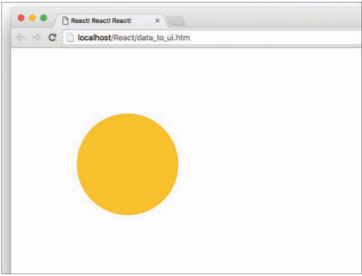
The Example
The bulk of what you see comes from the Circle component:

Slide 4
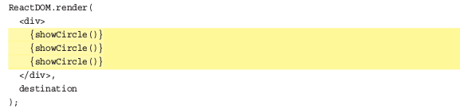

Dealing with Arrays
When you’re displaying multiple components, you can’t always manually specify them:
In many real-world scenarios, the number of components you display is related to the number of items in an array or array like object you’re working with.

Slide 5
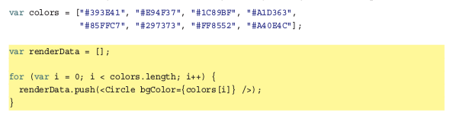
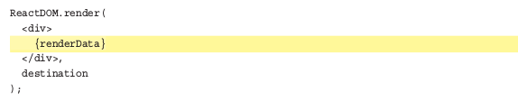
Dealing with Arrays
We want to create a Circle component for each item in this array. We can do this by creating an array of Circle components:
React makes displaying all of these components very simple.

Slide 6

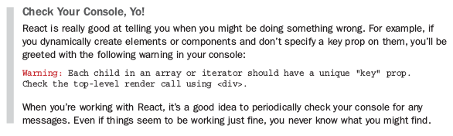
Dealing with Arrays
That extra work takes the form of a key prop whose value React uses to uniquely identify each particular component.

Slide 7
Dealing with Arrays
Instead of push Component <Circle /> in array renderData, you can return and render Component instantly by using map function like this:
const renderData = () => {
return colors.map((color, index) => {
return (
<Circle key={index + color} bgColor={color} />
);
})
}
This is the best practice when you want to render Component from array data. However, please read about map function carefully if you don’t understand it fully

Slide 8
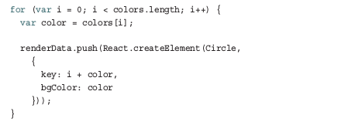
Conclusion
JSX is JavaScript. This is what allows you to have your JSX live wherever JavaScript thrives.
Even though we’re pushing pieces of JSX to an array, just like magic, everything works in the end when renderData is evaluated inside our render method. I hate to sound like a broken record, but this is because what our browser ultimately sees looks like this:

